Slide 1
NBA Player Statistics Analysis by Decade
By: Cy Seeley, Arya Tatke, John Apel, Anthony Vo

Slide 2
Introduction
Focus of this project was collecting and analyzing NBA player statistics from the 1970s to the 2020s
Our goal was to compile a comprehensive dataset containing:
Player career stats- grouped by the decade in which players began their careers
Analyze trends in player performance metrics including points, rebounds, and assists over time while comparing domestic and foreign players’ contributions

Slide 3
Questions to answer
How do key performance metrics (points, rebounds, assists) vary across decades for NBA players?
Are there trends in player performance or career longevity over time, and how do these differ between domestic and foreign players?
Which players or seasons stand out as exceptional within each decade, particularly among foreign players?
How has the contribution of foreign players to NBA performance metrics evolved over the decades?

Slide 4
Dataset
The dataset consists of career statistics for a sample of NBA players who started their careers between 1970 and 2025, grouped by decade
The dataset could be used in many different fields:
Sports analytics
Data science
Historical analysis
Business and marketing
Notes:
We can mention the fields in the dataset while speaking, but we don’t need to have them on the slide
Sports Analytics: To study trends in player performance, team dynamics, or the evolution of basketball strategies, with a focus on the impact of foreign players.
Data Science: To apply statistical modeling, machine learning, or visualization techniques to uncover patterns in player statistics, including differences between domestic and foreign players.
Historical Analysis: To compare the performance of domestic and foreign players across different eras of the NBA.
Business and Marketing: To analyze player popularity or impact, especially for foreign players, for marketing campaigns or team management decisions.

Slide 5
Preprocessing
Player sampling
Data retrieval
Decade labeling
Foreign player identification and integration
Data consolidation
Error handling
Data storage

Slide 6
Analysis Methods
Data exploration
understand player stats and nationality distributions.
Visualization
bar plots (top countries, scorers), box plots (points distribution), and line plots (decade trends)
Statistical analysis
Calculated mean stats (PTS, REB, AST) for groups and decades, with group comparisons (foreign vs. all players).
Outlier detection
Identified outliers in points distribution via box plots, highlighting performance variations.
Trend analysis
Examined stat trends across decades (e.g., 1970s: 414.52 PTS, 2020s: 394.53 PTS) and player counts.
Foreign player contribution
Analyzed foreign player representation (% per decade) and performance (e.g., Foreign: 536.20 PTS vs. Overall: 451.01 PTS).

Slide 7
Program overview
Key Features:
Data Collection: Samples 50 players/decade via nba_api, saves to nba_players_by_decade.csv.
Foreign Analysis: Filters non-U.S. players, compares stats.
Visuals: Bar/box/line plots for country representation, top scorers, decade trends.
Insights: Tracks stats (e.g., 1970s: 414.52 PTS, Foreign: 536.20 PTS) and foreign player growth.
Tools: Python, Pandas, Seaborn, Matplotlib, nba_api, Google Colab.
Output: CSVs (nba_players_by_decade.csv, foreign_vs_decade_players_avg.csv) and visualizations.
Challenges: API timeouts, deprecated Pandas warnings.

Slide 8
Results and Findings
The script was able to collect NBA player stats from the 1970s to the 2020s
A few of the observations include:
Average performance by decade
Average stats by decade
Points per game distributed by decade
Findings:
Performance trends: Points peaked in 1980s, rebounds in 2000s/2010s, assists in 1990s.
Foreign players (e.g., Nowitzki, Divac) outperformed overall averages (536.20 PTS vs. 451.01).
Foreign player presence grew significantly in 2010s/2020s.

Slide 9
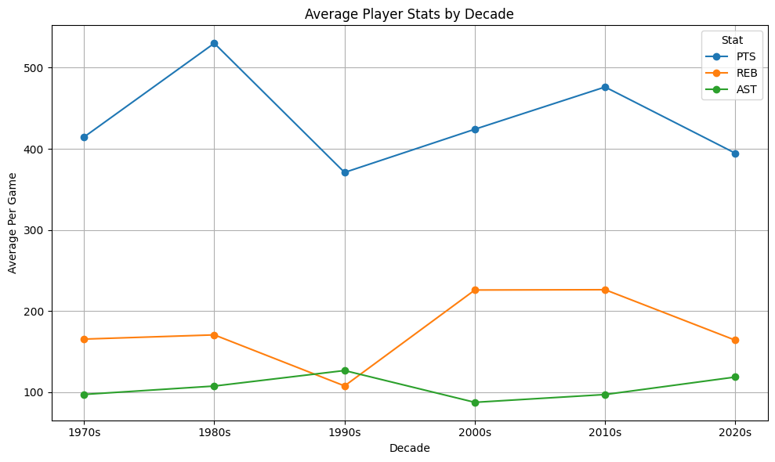
Results
Notes:
Average Performance by Decade:
The dataset reveals average season statistics per decade:
1970s: 414.52 PTS, 165.50 REB, 97.32 AST
1980s: 530.07 PTS, 170.70 REB, 107.64 AST
1990s: 370.90 PTS, 107.81 REB, 126.77 AST
2000s: 424.13 PTS, 225.99 REB, 87.58 AST
2010s: 476.19 PTS, 226.37 REB, 97.19 AST
2020s: 394.53 PTS, 164.12 REB, 118.76 AST
The 1980s exhibited the highest average points, likely due to high-paced gameplay, while rebounds peaked in the 2000s and 2010s, reflecting dominant frontcourt play. Assists were highest in the 1990s, suggesting a focus on playmaking.

Slide 10
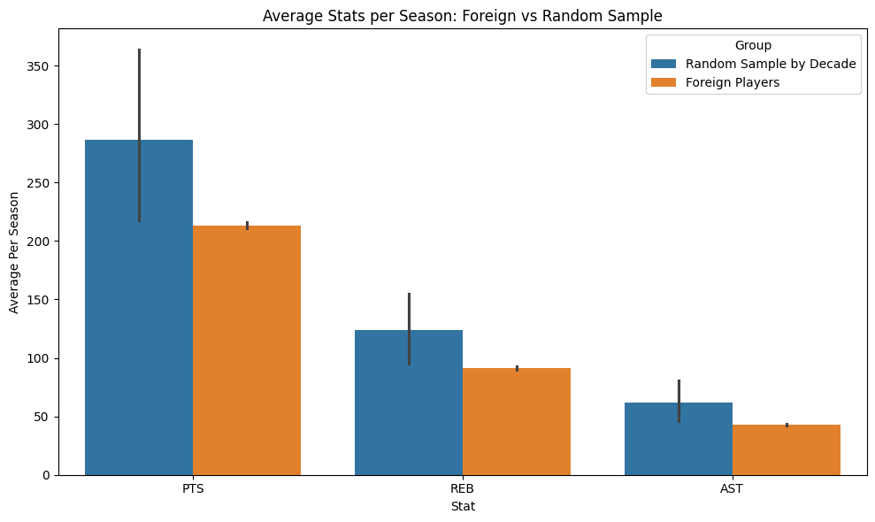
Results
Notes:
Domestic vs. Foreign Player Performance:
In the decade dataset, foreign players outperform overall averages: Foreign (536.20 PTS, 245.45 REB, 129.73 AST) vs. Overall (451.01 PTS, 188.59 REB, 102.54 AST), suggesting the sampled foreign players are high performers.
However, a broader comparison using per-player averages shows foreign players with lower stats (213.24 PTS, 91.11 REB, 42.92 AST) compared to the random sample (286.77 PTS, 124.01 REB, 61.55 AST), possibly due to differences in sample size or aggregation methods.
A bar plot comparing average PTS, REB, and AST for foreign vs. random sample players highlights these differences, with the random sample showing higher averages.

Slide 11
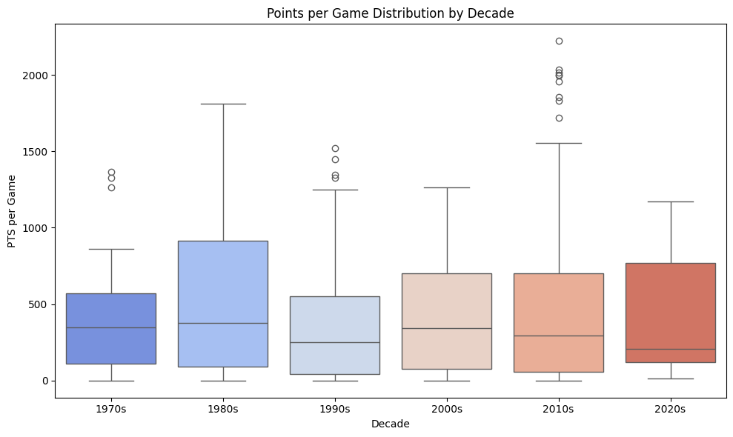
Results
Notes:
A boxplot of points per game by decade indicates increasing variability in the 2010s/2020s, suggesting diverse scoring roles and the influence of high-scoring foreign players.

